Slide 1

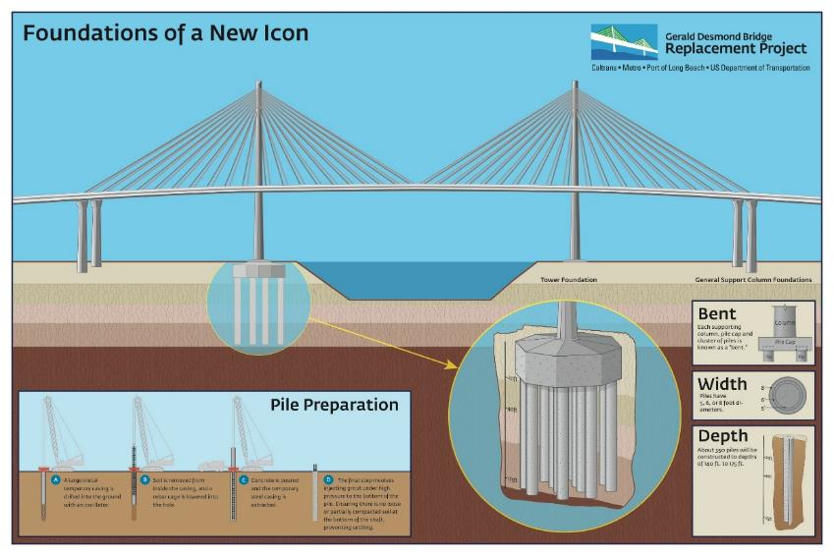
Port of
Long Beach
Gerald Desmond Bridge Replacement Project
“Foundations of a New Icon” Infographic
Visual-only Presentations

